Slide 1
Analysis of
FE-LG Campaigns
from Sept to Nov 2018
REDWOOD ALGORITHMS
Arpan Sarkar

Slide 2
Top Actionable
51 % Improvement for Insurance Campaign can be made by
Calling @9AM-11AM(Morning Time), 2pm,3:30-4pm(After Noon time) for more conversions rate.
Sales Team made more number of calls to customer in less interval of time.
Tuesday - Thursday best for closing sale.
Best target age group is 25 to 31.
Increasing contact to customer with follow up needed.
REDWOOD ALGORITHMS

Slide 3
Summary Metrics for FE_LG Campaign
Key Metrics | Product Insurance
Sales BTD Sales MTD | 1st SEP– 30th Oct = 408 sales
Conversion / Lead | 408/140000 = 9.05
Time to convert | 1.5 min (approx.)
Number of Products X - Sell | 408
(80:20) Rule - Team Lead | 708
(80:20) Rule - Sales Executive | Nguyá»…n VÄƒn KhÃ¡nh Employee Code(48818)
(80:20) Rule - Day of the Week | Tuesday, Wednesday and Thursday
(80:20) Rule - Time of the year | October (49.10%)
Target Segment | Age – 27-31yrs
REDWOOD ALGORITHMS

Slide 4
Modeling : Identifying Golden Segment for FE_LG
Dependent Variable (Target) : Golden Segment
60 Customers with lowest average time to convert = 1 else = 0.
Independent variables - . Age, campaign_team_708, sale_team_r , day_of_call , Avg_call_duration, Vietnam call time
Dataset : 5881
Split 70:30 –
Training - 4118
Testing – 1692
Multicollinearity – 1. sales_team_name, user_id, slaes_mngr, sales_admin,
2. disposition_status and subdisposition_sataus
Dummy Variables – No_of_calls
 | Age_group | Campaign_team | Average call duration | subdisposition_status | Day_of_call
Golden Segment | Chisq test | Chisq test | 2 sample t-test | Chisq test | 2 sample t-test
P value | < 0.5 | < 0.5 | < 0.5 | < 0.5 | < 0.5
REDWOOD ALGORITHMS

Slide 5
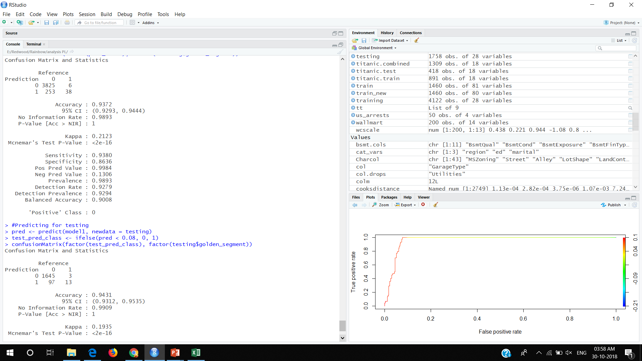
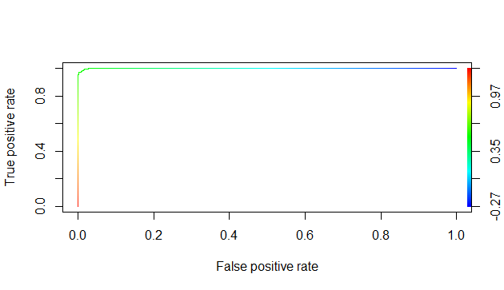
Training
Testing
Accuracy = 93.7 %
Accuracy = 94%
REDWOOD ALGORITHMS

Slide 6
Presenting the modelling Result
Attribute (Variable) | Influencing Factor ( Drawn from Coefficient) | Actionable
Age | 60% | More conversion on targeted age group
Campaign team_708 | 80% | Combination of campaign with best team.
Sales Team | 70% | Follow up needed should be called quickly again for better response (State change = TSR)
Average call duration | 30% | Minimum average call time for per prospect should be 14.5 min
Vietnam Call Time | 65% | Maximum conversion happened on Tuesday Wednesday and Thursday
REDWOOD ALGORITHMS

Slide 7
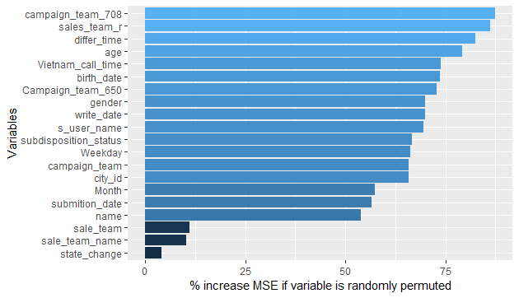
Independent Variable Significance

Slide 8
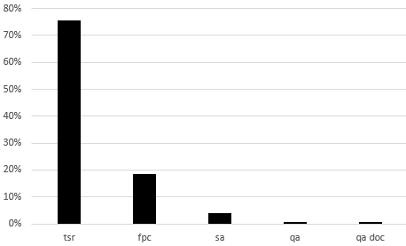
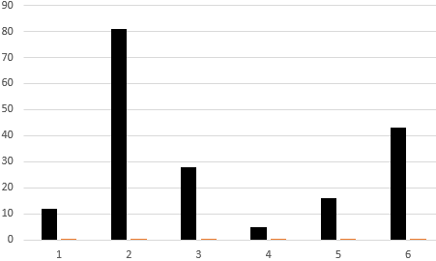
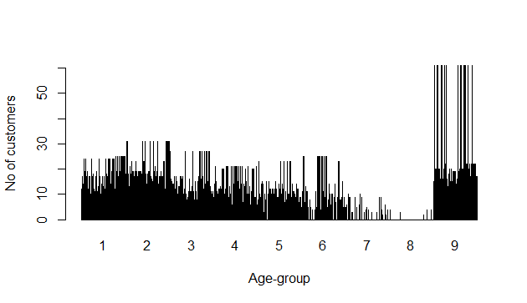
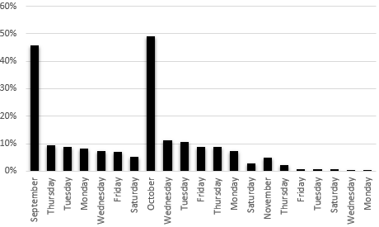
Percentage of customers in different stages
Percentage of customers in different disposition state
Count of conversions
Date of month
Ag group
Percentage of customers in different age buckets
No of customers conversion on Day and month wise

Slide 9
RATING OF CUSTOMERS
1. 5STAR customers:- Age group belonging to 25-31, campaign_team-708
SalesTeam-Group48818,50379,44046,45913,40572,44108
2. 4STAR customers:-Age group belonging to 25-31, campaign_team-605,
SalesTeam-Group48818,50379,44046,45913,40572,44108
3.3STAR customers:- Age group belonging to 32-38, campaign_team-712,
Team-Group48818,50379,44046,45913,40572,44108

Slide 10
The end

